Slide 1
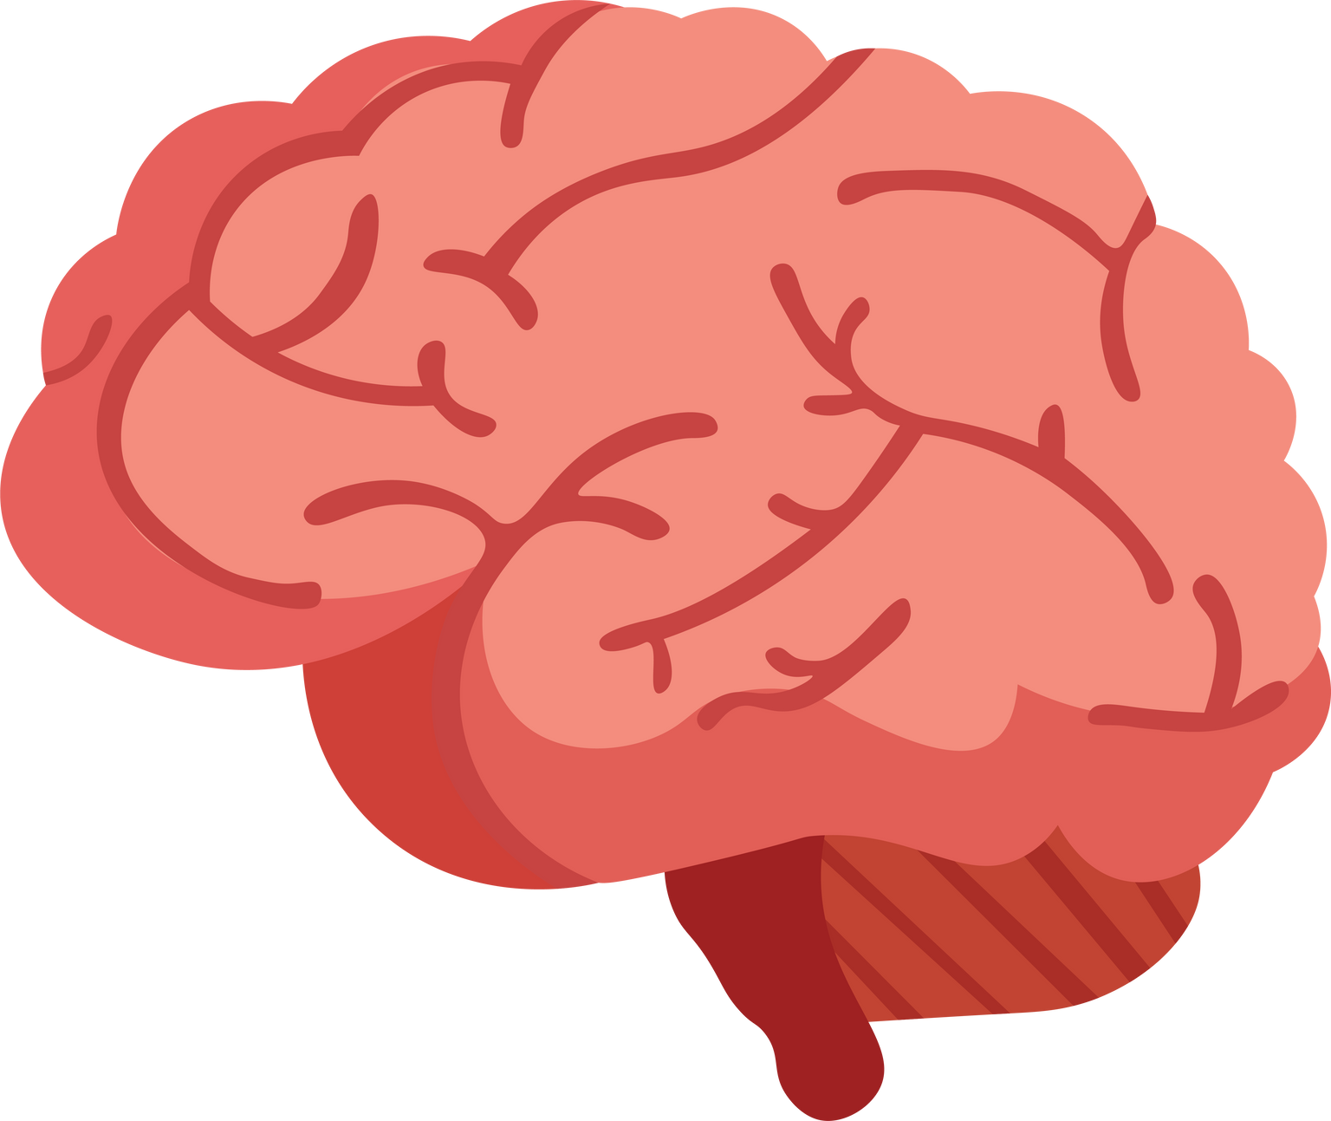
Welcome to the Class!

Slide 2
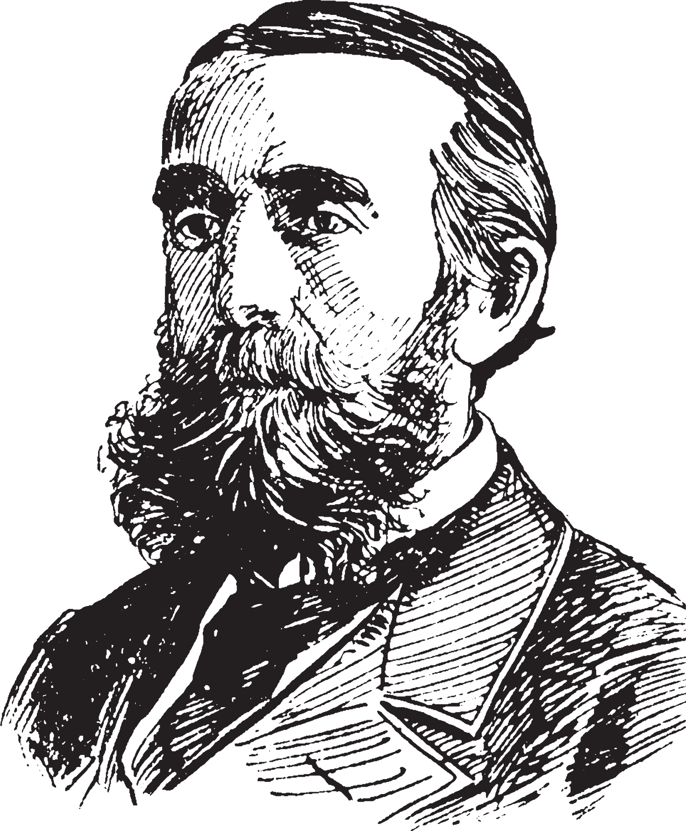
backround on me:
1. studying at cornell university
2. favorite hobby is inspiring love for learning through youtube/blogging

Slide 3
feel free to ask questions
Not urgent wait until end
raise your hand before asking

Slide 4
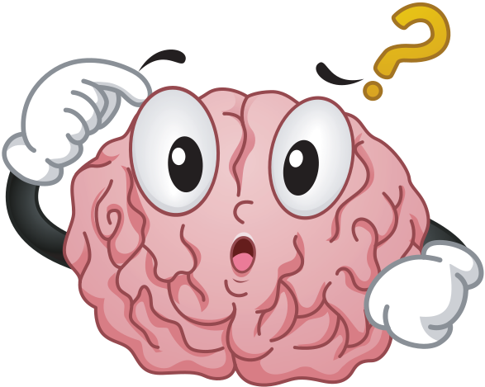
what study techniques do you use?

Slide 5
questions to keep in mind:
1. do my study techniques require effort?
2. Do I enjoy the process of learning?
3. Do I run away or accept failure?

Slide 6
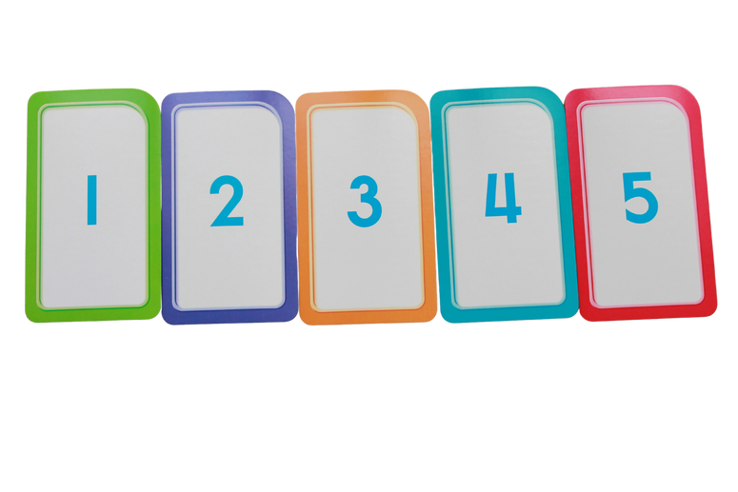
What you will learn:
1. Carol Dweck's growth mindset
2. Common study trap
3. concepts of effective studying
4. actionable study techniques

Slide 7
carol dweck's Study
group 1:
group 2:
taught about how effortful learning makes you smarter
taught about brain and studying

Slide 8
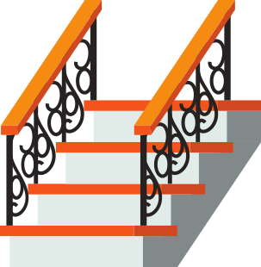
kids adopted a growth mindset
group 1:
group 2:

Slide 9
Why does this matter?
1. you are more than your genetics
2. accept failure is part of the process
3. Makes learning fun

Slide 10
questions?
don't be shy!

Slide 11
common high school study traps:
rereading notes
2. passively highlighting
3. studying lolz?

Slide 12
mass cramming
1. works amazingly in the short term
2. your forget everything after the test
3. makes you feel smart in the moment

Slide 13
"Learning is deeper and more durable when it’s effortful. Learning that’s easy is like writing in sand, here today and gone tomorrow." - Make it stick

Slide 14
exposure effect
"the belief that you know something simply because you have been exposed to it many times."

Slide 15
mentimeter!
try your best!

Slide 16
Concepts of effective studying:
1. active vs. passive studying
2. spaced repition
3. Interleaved practice
4. dynamic testing

Slide 17
mentimeter!
try your best!

Slide 18
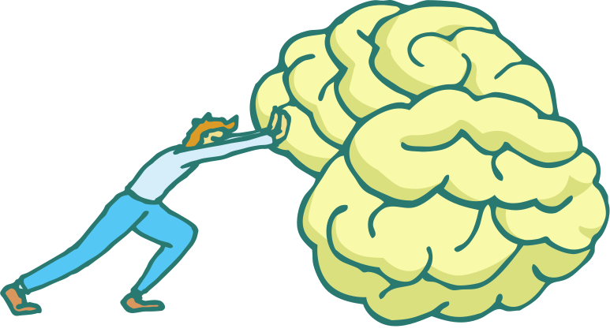
active vs. passive studying:
active studying:
passive studying:
takes effort
easy to replicate
increases myelin around nerves
suffers to exposure effect
facilitates long term memory
terrible for long term memory

Slide 19
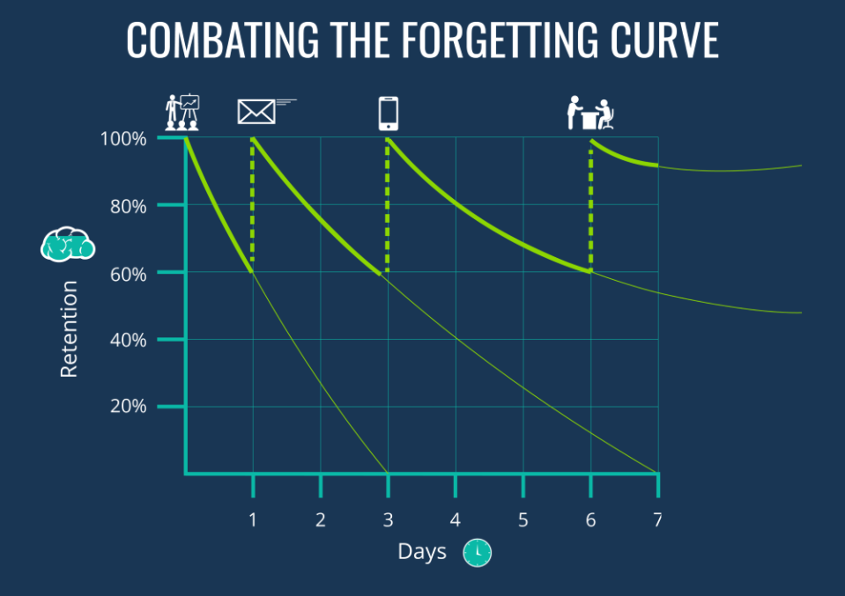
spaced repetition:

Slide 20
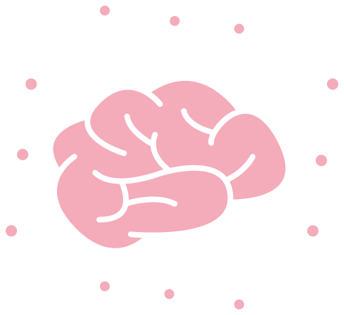
interleaved practice:
benefits:
1. your tests will study you on everything
2. Fasciliates more neuron connections

Slide 21
dynamic testing:
benefits:
1. reveals areas of weakness
2. gives your study sessions focus
3. mimics what the test will be like

Slide 22
mentimeter!
try your best!

Slide 23
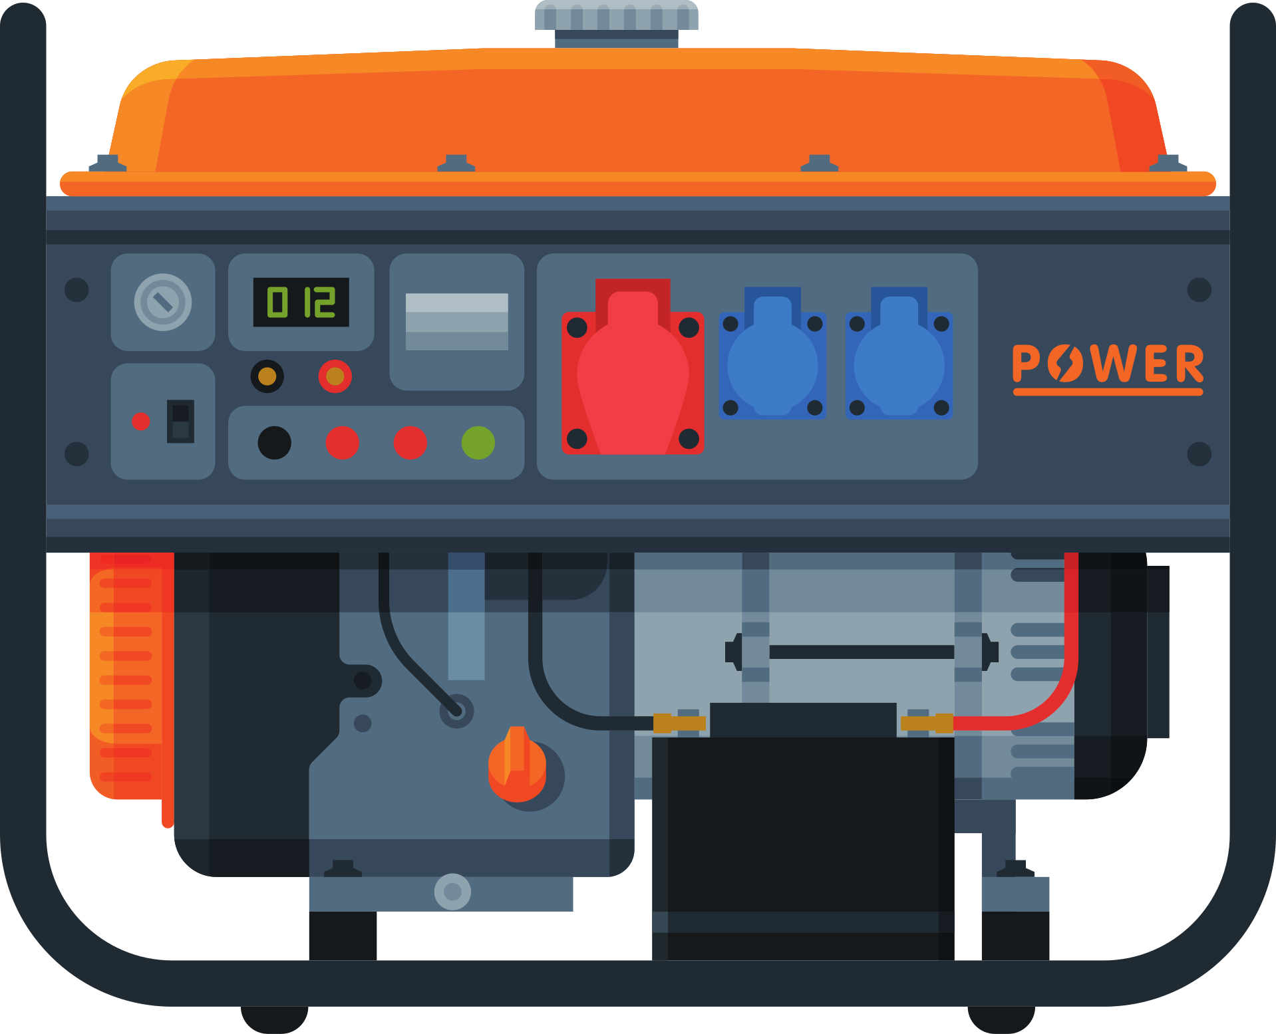
bonus! generative learning:
solving problems you don't know the answer to

Slide 24
questions?
don't be shy!

Slide 25
effective studying techniques:
flashcards
practice tests
teaching

Slide 26
congratulations!
aidan helfant
aidanlifeadvice.com
habit-changing basics

Slide 27
questions?
don't be shy!

